Slide 1
A Ground Breaking Initiative To Combat Climatic Changes
Let us introduce some aspects that increases global warming.
Do You Know
What Initiative can we take to Reduce Global Warming?
How Global Warming Affects Climatic Changes ?
Greenhouse Gas Emissions
Industrial Processes
Land Use Changes
Natural Factors
Feedback Mechanisms
….and many more

Slide 2
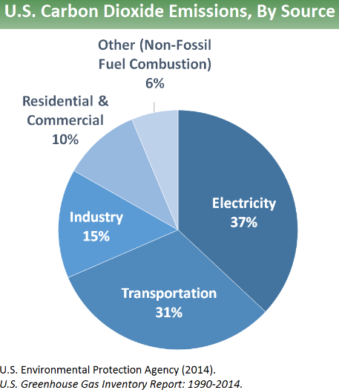
Greenhouse Gas Emissions
Carbon Dioxide (CO2): Primarily from burning fossil fuels (coal, oil, and natural gas) for energy and transportation, as well as deforestation.
Methane (CH4): Released from agriculture (especially livestock), landfills, and natural gas extraction.
Nitrous Oxide (N2O): Emitted from agricultural and industrial activities, as well as combustion of fossil fuels and biomass.
Fluorinated Gases: Synthetic gases used in industrial applications, with a much higher warming potential than CO2.
Industrial Processes
Chemical Processes
Distillation: Separation of mixtures based on differences in boiling points (e.g., crude oil refining).
Chemical Reaction Engineering: Design and operation of chemical reactors to produce desired chemical products.
Electrolysis: Using electric current to drive a non-spontaneous chemical reaction (e.g., aluminum production).

Slide 3
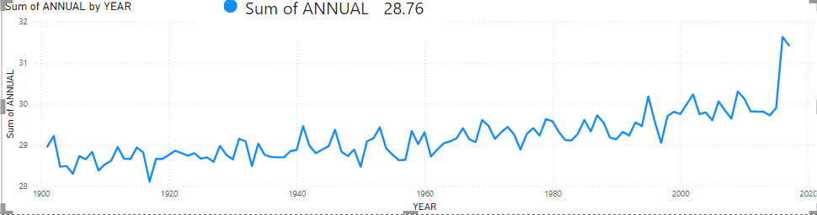
The Average Annual Temperature
Here we can see that the average annual temperature 1n the year 1900 was around 29’c but after the year 2015 it increases up to 31.63’c the increment of temperature after the year of 2016 was around 5.78% which is effectively high.

Slide 4
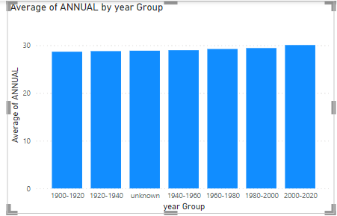
Average Annual Temperature By year Group
The Average Annual Temperature in 1900-1920 was 27.2’ c
All over India, But it has been increased during last two decades.
The reason that caused this changes where rapidly increments in industrialization, urbanization, relatively air pollution and exposures of harmful Radiation in Environment.
To control this climatic changes we have to shift towards an alternative way that can reduce this cause till some extent.

Slide 5
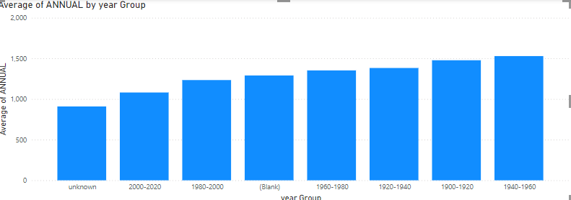
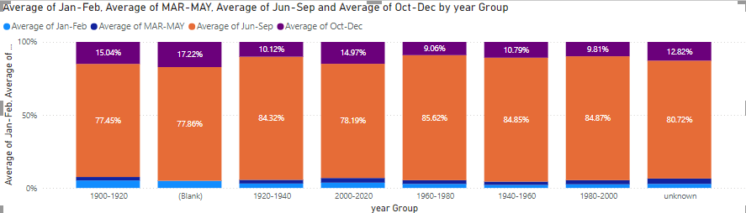
The Average Annual Rainfall Of India
The Average Annual Rainfall All over the India Is decreasing because of the temperature increment That is in the year of

Slide 6
Conclusion :
As Annual Average Temperature in India is increasing due to which Rainfall In India is decreasing that impact is easily visible therefore to reduce climatic changes we have to take some measures because both the results of our temperature and rainfall is not in our favor
Both the factors are inversely dependent that is as temperature increases
average annual rainfall decreases.

